Slide 1

Mortgage-Backed Securities:
Machines Learning Models on Prepayment Projections
May 12th | Spring 2022

Slide 2

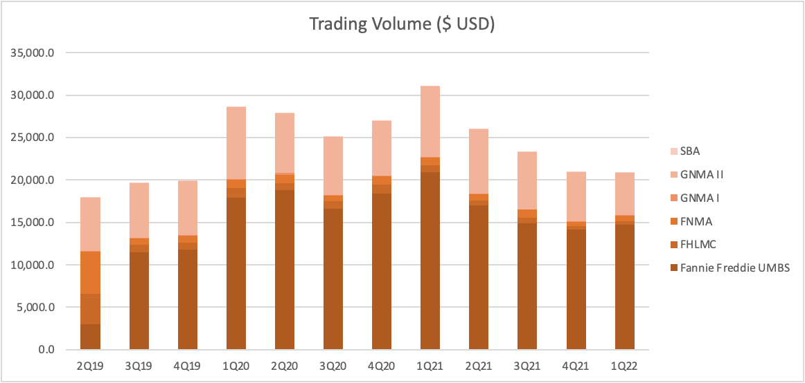
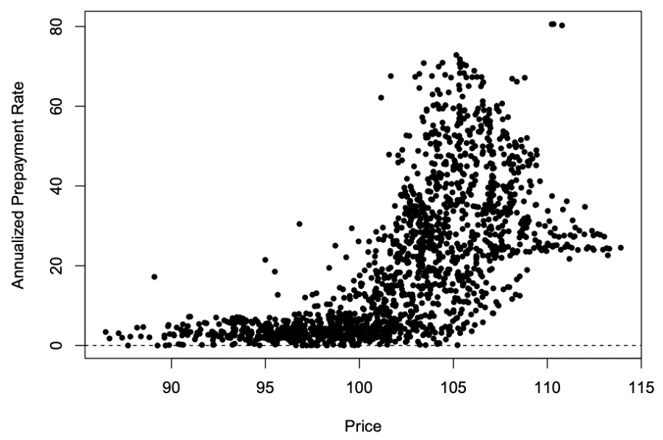
Overview
U.S. Agency Mortgage-Backed Securities market is one of the largest and most liquid bond markets worldwide
Snapshot
Influence of Prepayment
Mortgage-backed security is a securitized claim to the principal and interest payments generated by a pool of fixed-rate mortgages
Issuance (as of April) $990.2 billion, -43.7% Y/Y
Agency Trading (as of April) $271,819.3 million, -14.3% Y/Y
Non-Agency Trading (as of April) $1,444.2 million, -9.5% Y/Y
Outstanding (as of 4Q21) $12,201.6 billion, +9% Y/Y
The risk that a mortgage will be repaid earlier than the originally agreed termination date
Possibility of a prepayment risk premium; requires that prepayment dynamics be the same under risk-neutral and actual measures
Yield spread adjustment to discount rates, known as the option-adjusted spread
Reasons to Prepay
External
Interest Rate
House Price
Employment Rate
Seasonality
Refinance
Source: SIFMA, Fannie Mae, Freddie Mac, Internal Analysis
Notes:
In a paper published in the Review of Financial Studies, UCLA Anderson’s Mikhail Chernov, Brett R. Dunn, a Ph.D. student, and Francis Longstaff developed a model based on a cross section of all MBS to explore the market’s pricing-in of prepayment risk, and what factors beyond interest rates are responsible for the prepayment risk premium.
Using MBS data from 1998 to September 2014, the researchers’ model computed an average implied prepayment rate of 25 percent, which is significantly higher than the actual average prepayment rate of 21 percent during that stretch. That four-percentage-point gap represents a significant prepayment risk premium with real-world pricing implications. The higher implied prepayment rate would cause mortgages with below-market rates to be priced higher than the historical prepayment rate would suggest, and vice versa for mortgages with above-market rates
They estimate that more than 90 percent of the prepayment risk premium is driven by the market’s taking into consideration (pricing in) macroeconomic factors such as unemployment rates and changing home valuation trends. For instance, in rough economic times, rising unemployment can lead to homeowners’ moving or being foreclosed upon, or choosing to default on an underwater mortgage. In robust economic times when home prices are rising, homeowners may opt for a cash-out refinance that puts money in their pocket. Both the good-news and bad-news economic trends have the same prepayment end result for an MBS investor, and thus are measured together as the “turnover rate.”
The turnover rate explains the bulk of the gap between the implied and actual prepayment rates. The authors note that refinancing because of changes in interest rates is “of first order importance” in sussing out prepayment risk, given its large-volume footprint. In their model, they find that nearly 70 percent of prepayments were a result of “rate response”-related prepayments.*https://anderson-review.ucla.edu/prepayment-risk/
This figure plots the three-month prepayment rates for FNMA mortgage-backed securities against the prices of mortgage-backed securities. The prepayment rates are expressed as annualized percentages of the principal balance of the mortgage backed security. The data consist of monthly observations for all liquid coupons over the January 1998 to September 2014 sample period.
As shown, there is a strong relation between the prepayment rate and the price of the mortgage-backed securities. When the price of the mortgage-backed security is less than 100, the coupon rate on the mortgage is lower than the current market rate, and the borrower has no incentive to refinance. When the price is greater than 100, however, the borrower may be able to reduce his mortgage costs by refinancing. When the price of the mortgage-backed security is greater than 100, the relation is generally increasing, but spreads out as the price increases.

Slide 3
Data Cleaning
Initializing
Selection Criteria
Amortization Type: Fixed Rate Mortgage
Property Type: Single Family
Loan Term: equals to 360 terms
Loan Age: smaller than 120 terms
After selection, the total size of data becomes 17.1GB
Source: Fannie Mae, Freddie Mac, Internal Analysis

Slide 4
Data Cleaning
CPR & SMM Calculations
Clean Empty Columns
FMAE Empty Columns:
'Filler', 'Filler.1', 'Filler.2', 'Government Insured Guarantee', 'Modification Program', 'Modification Type', 'Number of Modifications', 'Total Capitalized Amount', 'Interest Bearing Mortgage Loan Amount', 'Original Deferred Amount', 'Current Deferred UPB', 'Loan Age As Of Modification', 'Estimated Loan-To-Value (ELTV)', 'Updated Credit Score', 'Filler.3', 'Interest Rate Step Indicator', 'Initial Step Fixed-Rate Period', 'Total Number of Steps', 'Number of Remaining Steps', 'Next Step Rate', 'Terminal Step Rate', 'Terminal Step Date', 'Step Rate Adjustment Frequency', 'Next Step Rate Adjustment Date', 'Months to Next Step Rate Adjustment Date', 'Periodic Step Cap Up Percent', 'Origination Mortgage Loan Amount', 'Origination Interest Rate', 'Origination Amortization Type', 'Origination Interest Only Loan Indicator', 'Origination First Payment Date', 'Origination Maturity Date', 'Origination Loan Term', 'Origination Loan-To-Value (LTV)', 'Origination Combined Loan-To-Value (CLTV)', 'Origination Debt-To-Income Ratio', 'Origination Credit Score', 'Filler.4', 'Filler.5', 'Filler.6', 'Origination Loan Purpose', 'Origination Occupancy Status', 'Origination Channel', 'Loan Performance History'
FMAC Empty Columns:
'Filler', 'Filler.1', 'Filler.2', 'Interest Only First Principal and Interest Payment Date', 'Months to Amortization', 'Prepayment Penalty Total Term', 'Index', 'Mortgage Margin', 'MBS PC Margin', 'Interest Rate Adjustment Frequency', 'Interest Rate Lookback', 'Interest Rate Rounding Method', 'Interest Rate Rounding Method Percent', 'Convertibility Indicator', 'Initial Fixed Rate Period', 'Next Interest Rate Adjustment Date', 'Months to Next Interest Rate Adjustment Date', 'Life Ceiling Interest Rate', 'Life Ceiling Net Interest Rate', 'Life Floor Interest Rate', 'Life Floor Net Interest Rate', 'Initial Interest Rate Cap Up Percent', 'Initial Interest Rate Cap Down Percent', 'Periodic Interest Rate Cap Up Percent', 'Periodic Interest Rate Cap Down Percent', 'Modification Program', 'Modification Type', 'Number of Modifications', 'Total Capitalized Amount', 'Interest Bearing Mortgage Loan Amount', 'Original Deferred Amount', 'Current Deferred UPB', 'Loan Age As Of Modification', 'Estimated Loan-To-Value (ELTV)', 'Updated Credit Score', 'Filler.3', 'Interest Rate Step Indicator', 'Initial Step Fixed-Rate Period', 'Total Number of Steps', 'Number of Remaining Steps', 'Next Step Rate', 'Terminal Step Rate', 'Terminal Step Date', 'Step Rate Adjustment Frequency', 'Next Step Rate Adjustment Date', 'Months to Next Step Rate Adjustment Date', 'Periodic Step Cap Up Percent', 'Origination Mortgage Loan Amount', 'Origination Interest Rate', 'Origination Amortization Type', 'Origination Interest Only Loan Indicator', 'Origination First Payment Date', 'Origination Maturity Date', 'Origination Loan Term', 'Origination Loan-To-Value (LTV)', 'Origination Combined Loan-To-Value (CLTV)', 'Origination Debt-To-Income Ratio', 'Origination Credit Score', 'Filler.4', 'Filler.5', 'Filler.6', 'Origination Loan Purpose', 'Origination Occupancy Status', 'Origination Channel', 'Loan Performance History'
Source: Fannie Mae, Freddie Mac, Internal Analysis

Slide 5
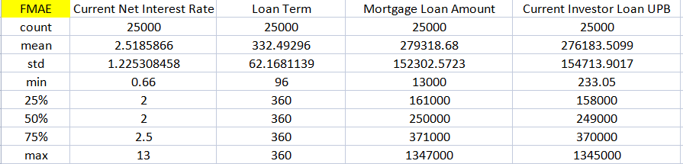
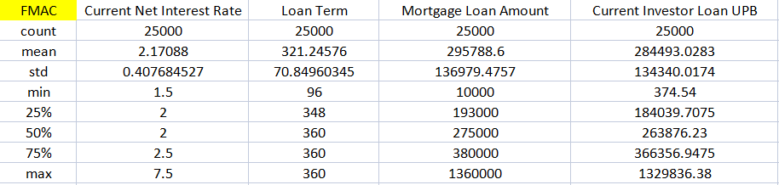
Initializing
Data Cleaning
A snapshot of data
Source: Fannie Mae, Freddie Mac, Internal Analysis

Slide 6
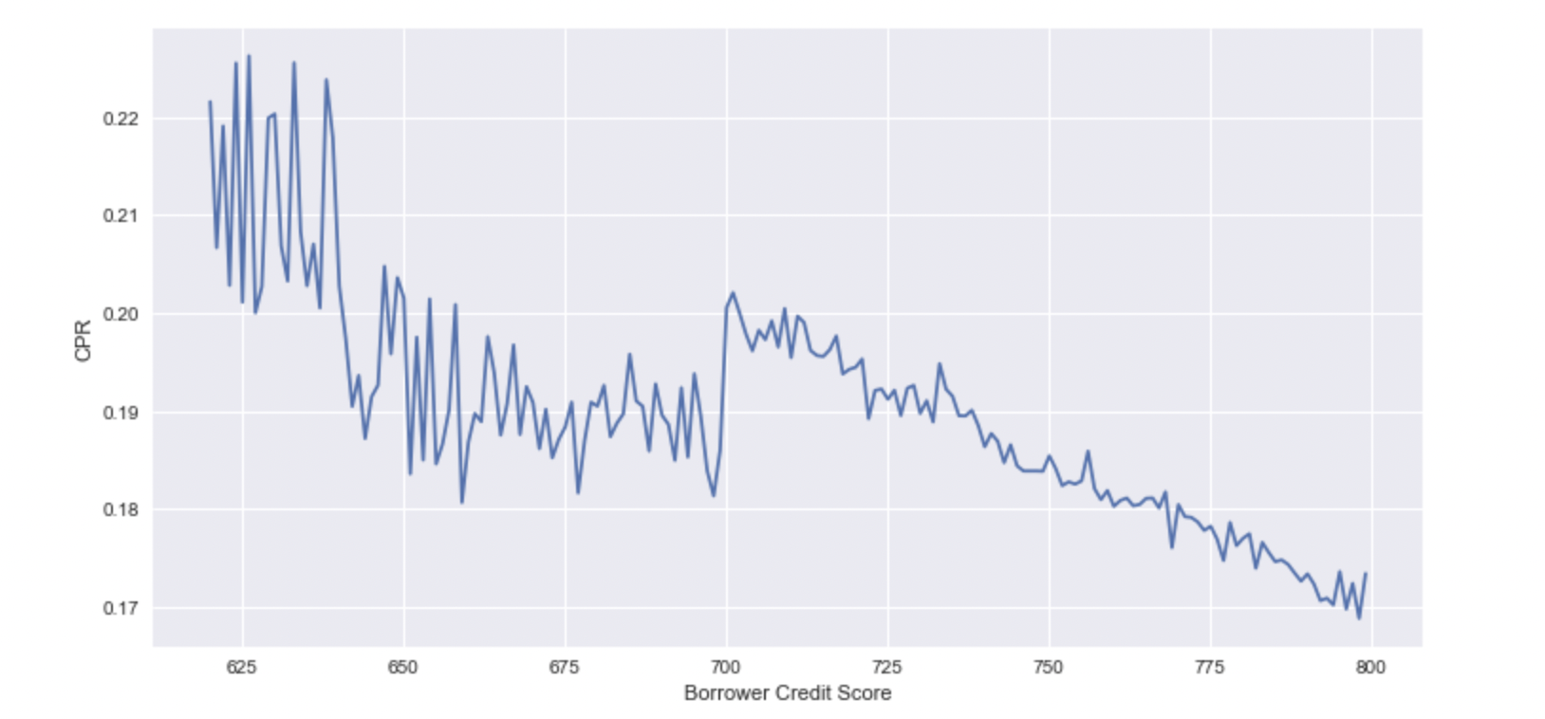
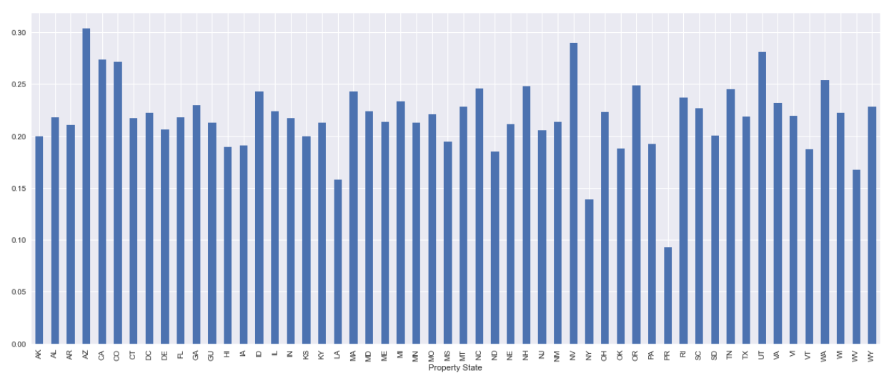
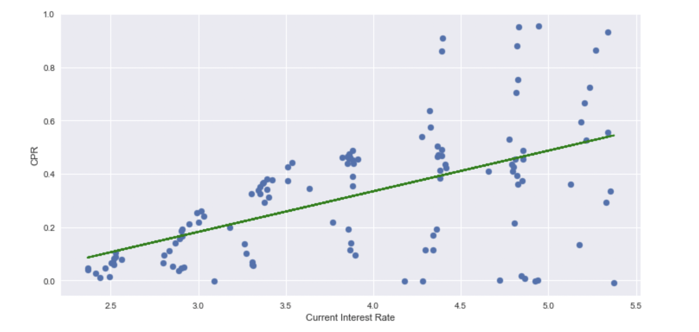
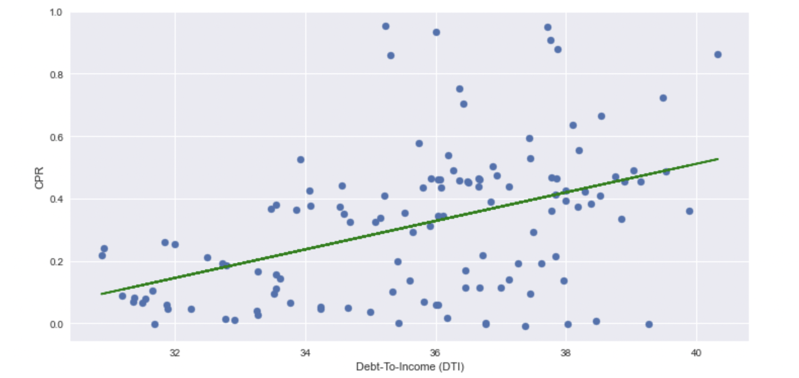
Prepayment Influencers
Visualization - variable selection
There are many possible input variables that are related to macroeconomic factors, mortgage characteristics, or clients’ specifics.
Borrower credit score
Geographic locations
Current interest rate
Debt to income ratio
Notes:
Credit score: Prepayment was on average higher for borrowers with low creditworthiness. Low FICO score borrowers tend to have a stronger refinancing incentive because of their high mortgage rate.
Interest rate: We analyze CPR to interest rate to see whether prepayment behavior is consistent with economic intuitions. There is a tendency that the higher the current interest rate, the higher the CPR. When interest rates increase, the price of an MBS tends to fall more quickly due to duration extension.

Slide 7
Prepayment Influencers
Variable We Selected
There are many reasons why borrowers decide to make prepayments on their mortgage loan. The factors might be related to borrowers' personal characteristics such as age, income, credit score, loan characteristics such as loan age, interest rate, prepayment penalty, and property type, and macroeconomic data such as month of the year, housing prices.
Given the prepayment prediction requirements, a mix of different parameters is needed
 | Borrowers’ personal characteristics |  | Loan characteristics |  | Macroeconomic data
 | First time home buyer | ✓ | Loan purpose | ✓ |  | Original Interest rate | ✓
 | Occupancy Status | ✓ | Chanel | ✓ |  | State | ✓
 | Debt to income | ✓ | Number of borrowers | ✓
 | Borrower credit score | ✓ | Loan Term | ✓
 |  |  | Loan Age | ✓
 |  |  | Loan to value | ✓
Source: Fannie Mae, Freddie Mac, Internal Analysis

Slide 8
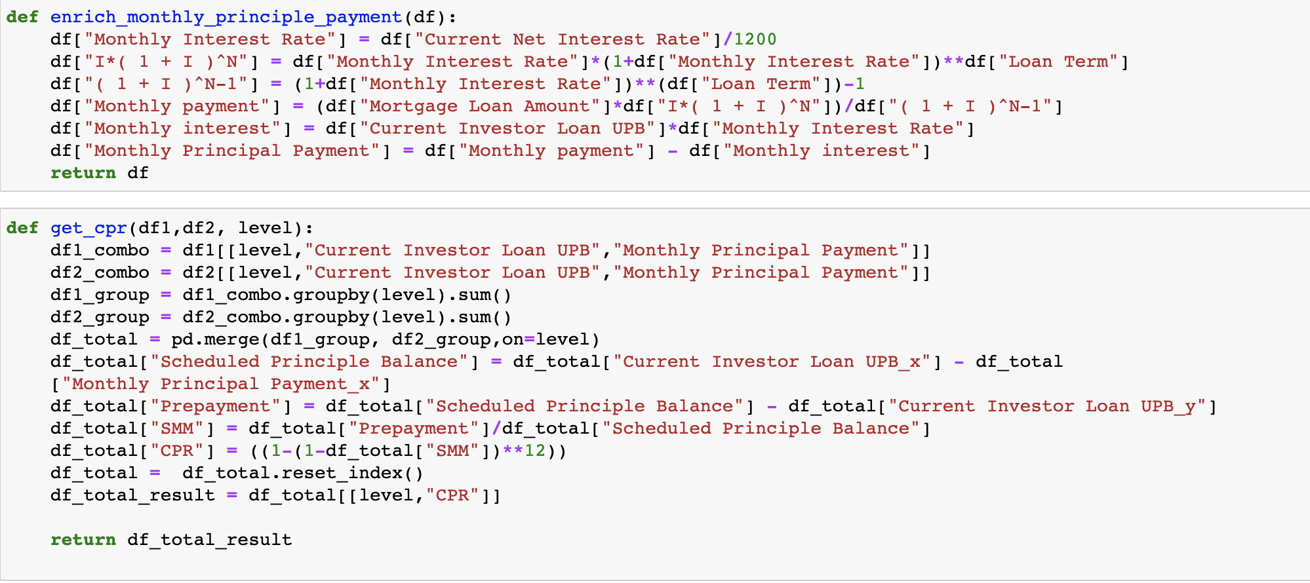
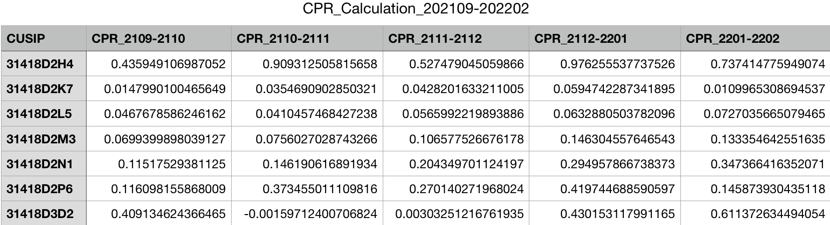
CPR Function

Slide 9
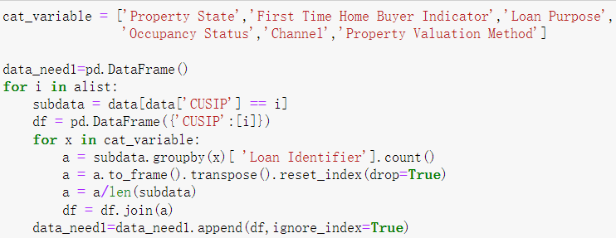
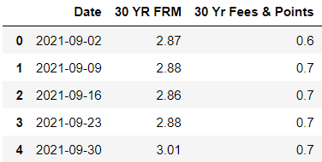
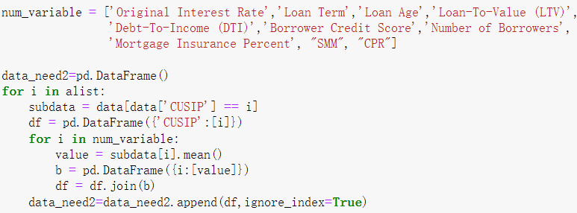
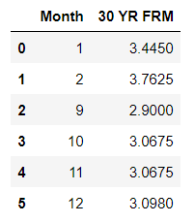
Dataframe Function
Aggregate Independent Variables
Add Mortgage Rate (PMM)

Slide 10
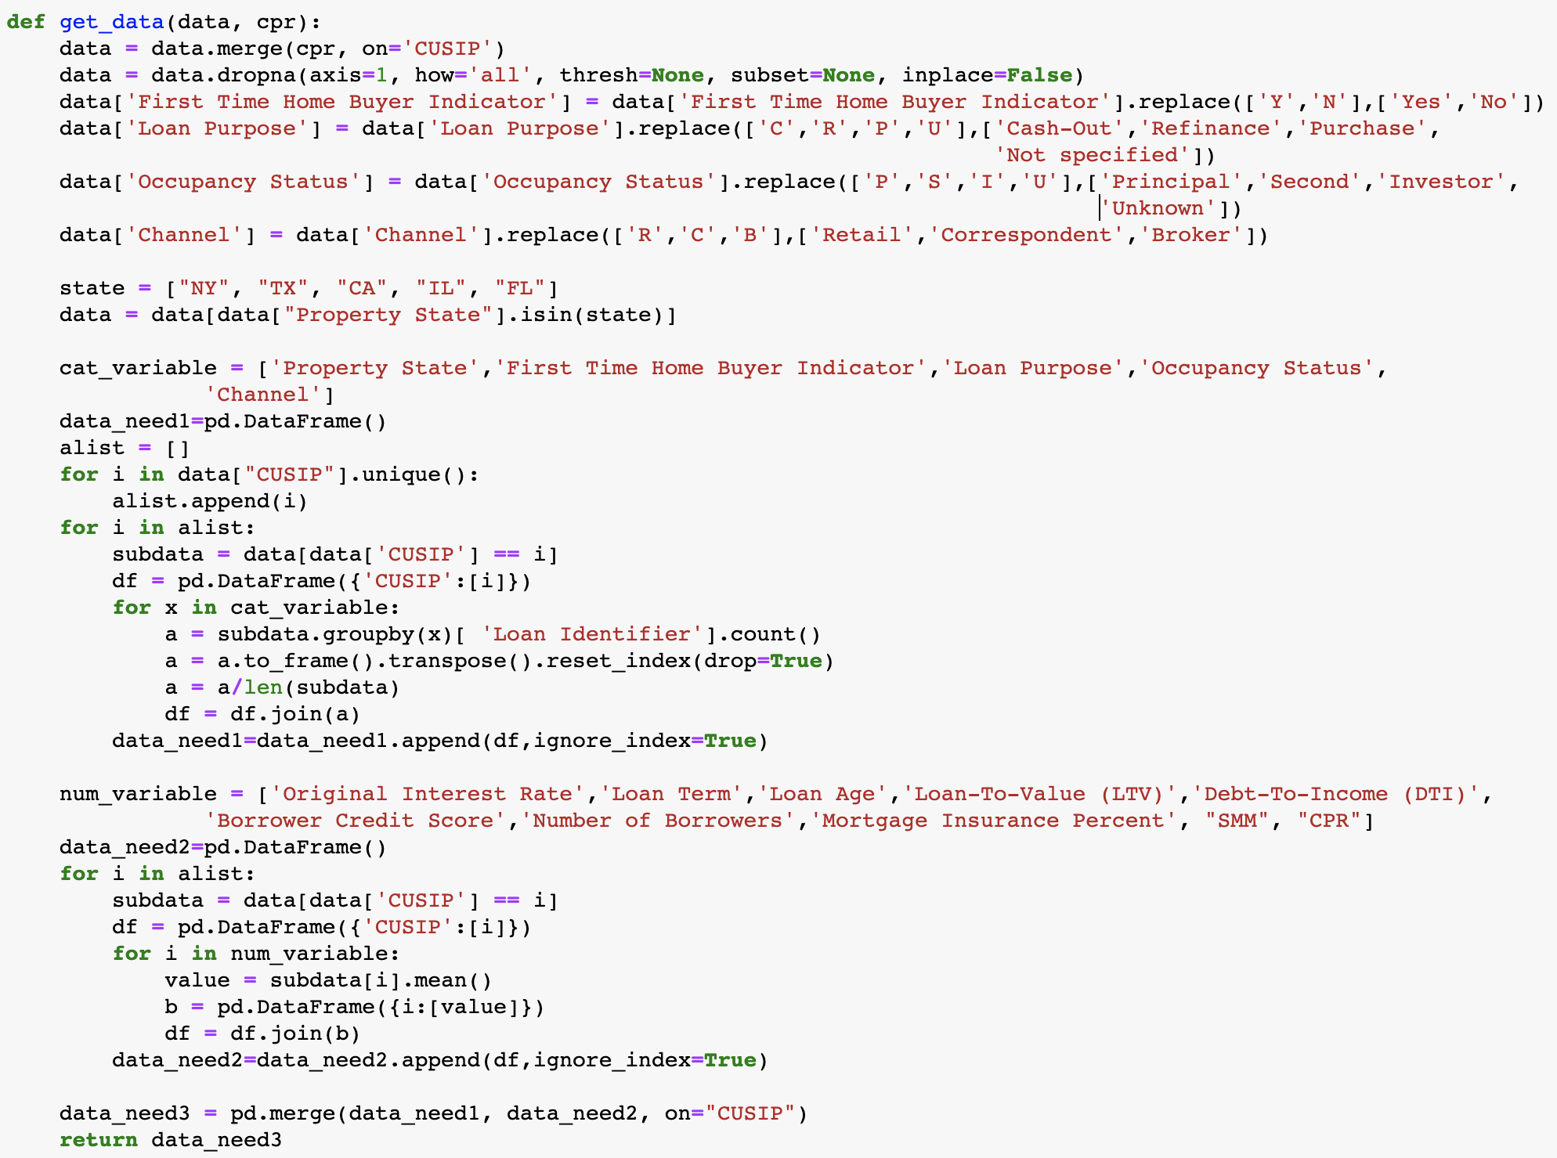
Dataframe Function

Slide 11
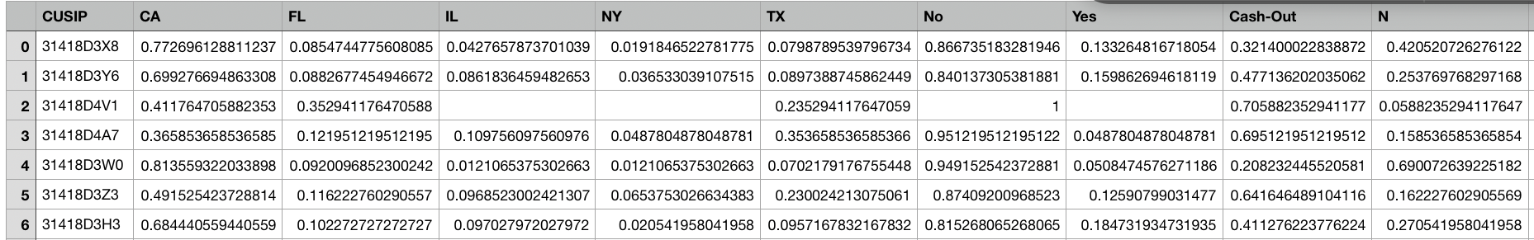
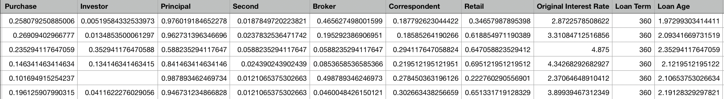
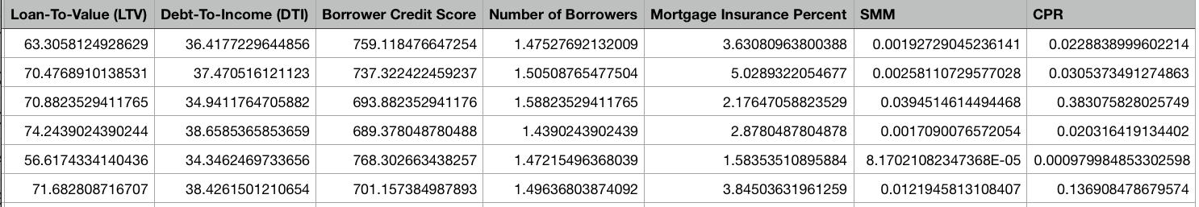
Dataframe Function

Slide 12
Our Models
Models
Our Rationale
Machine Learning
We first used Month t’s SMM to regress on Month (t-1)’s independent variables
CA,FL,IL,NY,TX,No,Yes,Cash-Out,Purchase,Investor,Principal,Second,Broker,Correspondent,Retail,Original Interest Rate,Loan Term,Loan Age,Loan-To-Value (LTV),Debt-To-Income (DTI),Borrower Credit Score,Number of Borrowers,Mortgage Insurance Percentage
1
2
We then used January’s data to predict the SMM in February, and calculated the corresponding accuracy of our model accordingly.
3
We then used February’s predicted SMM to calculate February’s predicted CPR and compared it to the actual CPR in February.
4
Finally, we used February’s data to predict the SMM and CPR of March.
Source: Fannie Mae, Freddie Mac, Internal Analysis

Slide 13
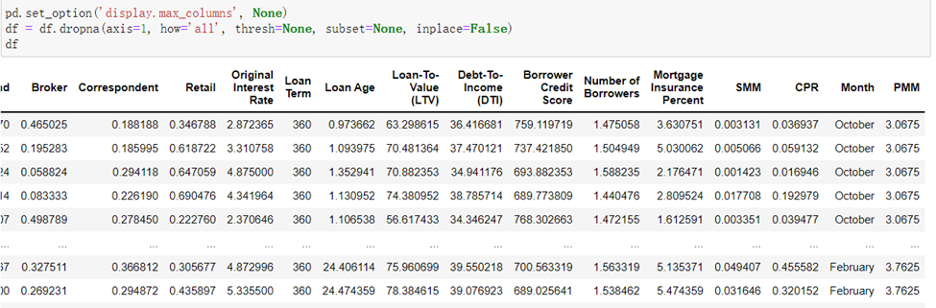
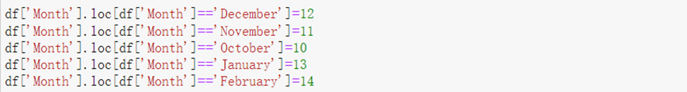
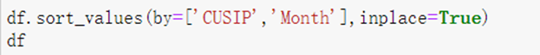
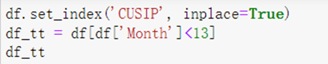
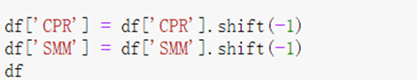
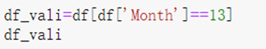
Linear Regression
Linear Regression
Data loading and processing
1
2
3
Source: Fannie Mae, Freddie Mac, Internal Analysis
Notes:
We first load our data frame, which is a 625*29 data frame.
We then adjust the dataframe, to combine this month’s independent variables with next month’s dependent variable, so that later it would be easier for us to use this month’s data to make predictions for the next month.
February’s data is deleted because we don’t have March’s dependent variable. January’s data is separated as the testing data for vlidation. and the other months’ data are used as training data

Slide 14
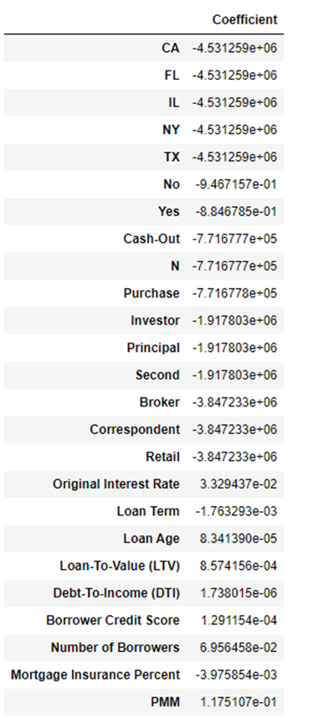
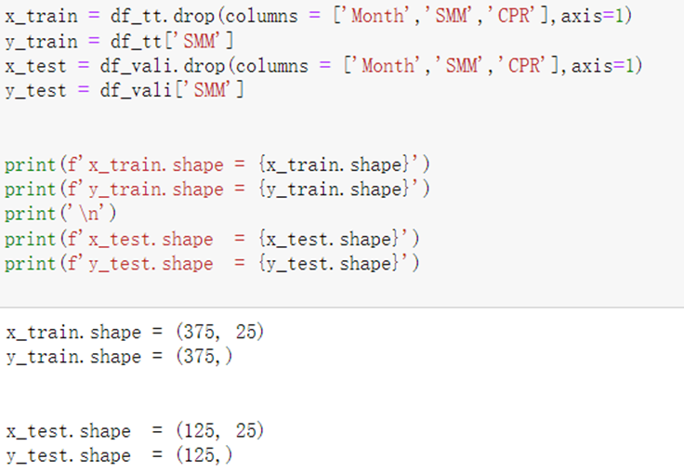
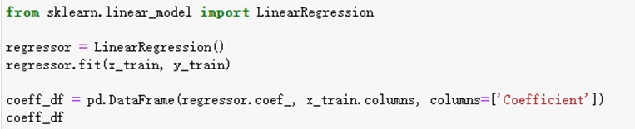
Linear Regression
Linear Regression
Model Training
Source: Fannie Mae, Freddie Mac, Internal Analysis
Notes:
We then explicitly specify the training data and train our model. The relevant coefficients are obtained as follows

Slide 15
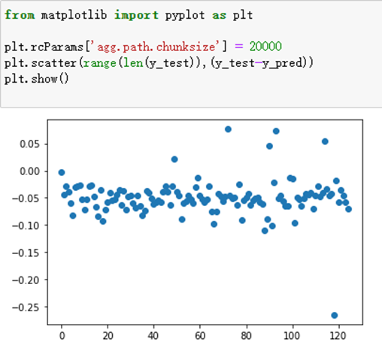
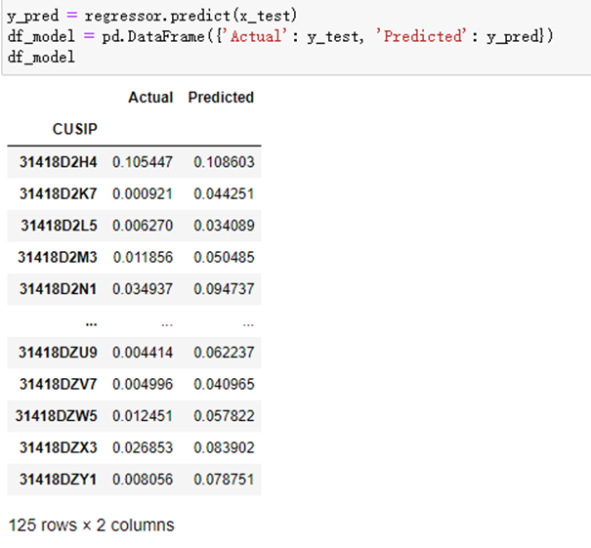
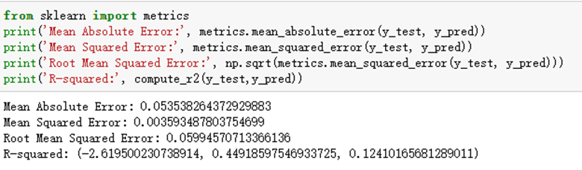
Linear Regression
Linear Regression
Model Testing and data prediction
Source: Fannie Mae, Freddie Mac, Internal Analysis
Notes:
We then use January’s data to predict February’s SMM and test the accuracy and efficiency of our model. We get RMSE of …. and negative r-squared, which means the model is worse than fitting a horizontal line. not a good model

Slide 16
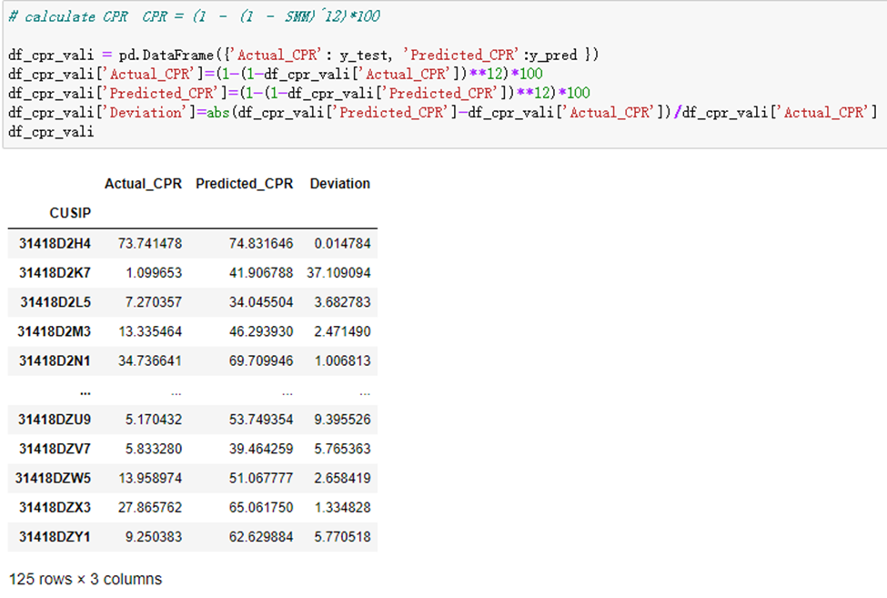
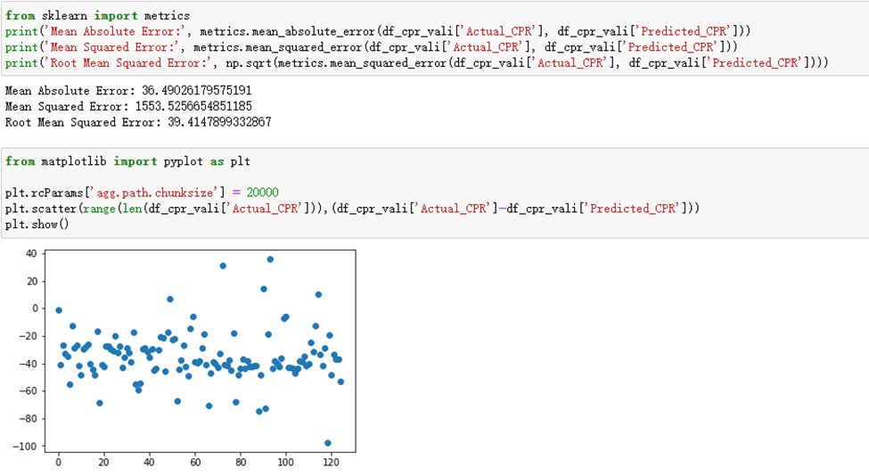
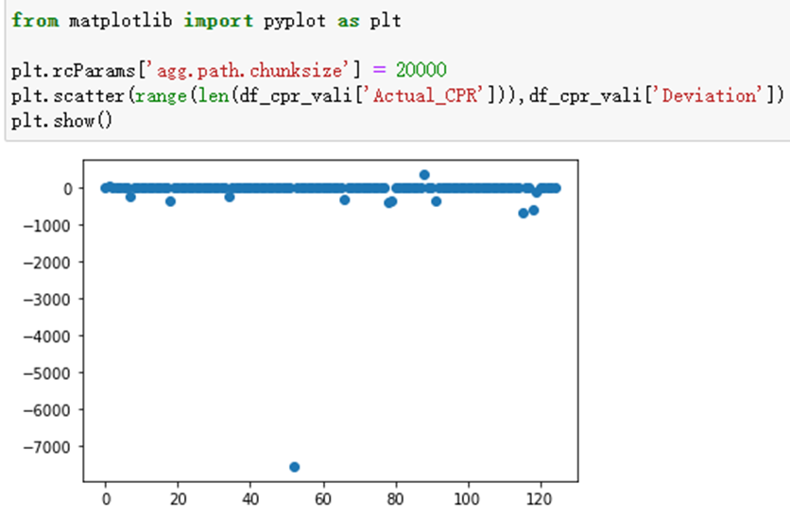
Linear Regression
Linear Regression
CPR Deduction
Source: Fannie Mae, Freddie Mac, Internal Analysis
Notes:
We then use the SMM we predicted to deduct CPR. And here is the accuracy of our prediction

Slide 17
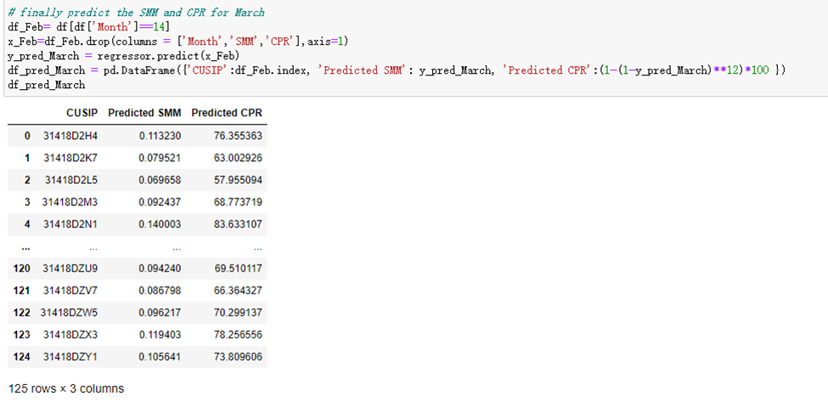
Linear Regression
Linear Regression
SMM and CPR for March
Source: Fannie Mae, Freddie Mac, Internal Analysis
Notes:
Finally, we used our model to make a prediction for March’s SMM and CPR but of course we can’t validate our results

Slide 18
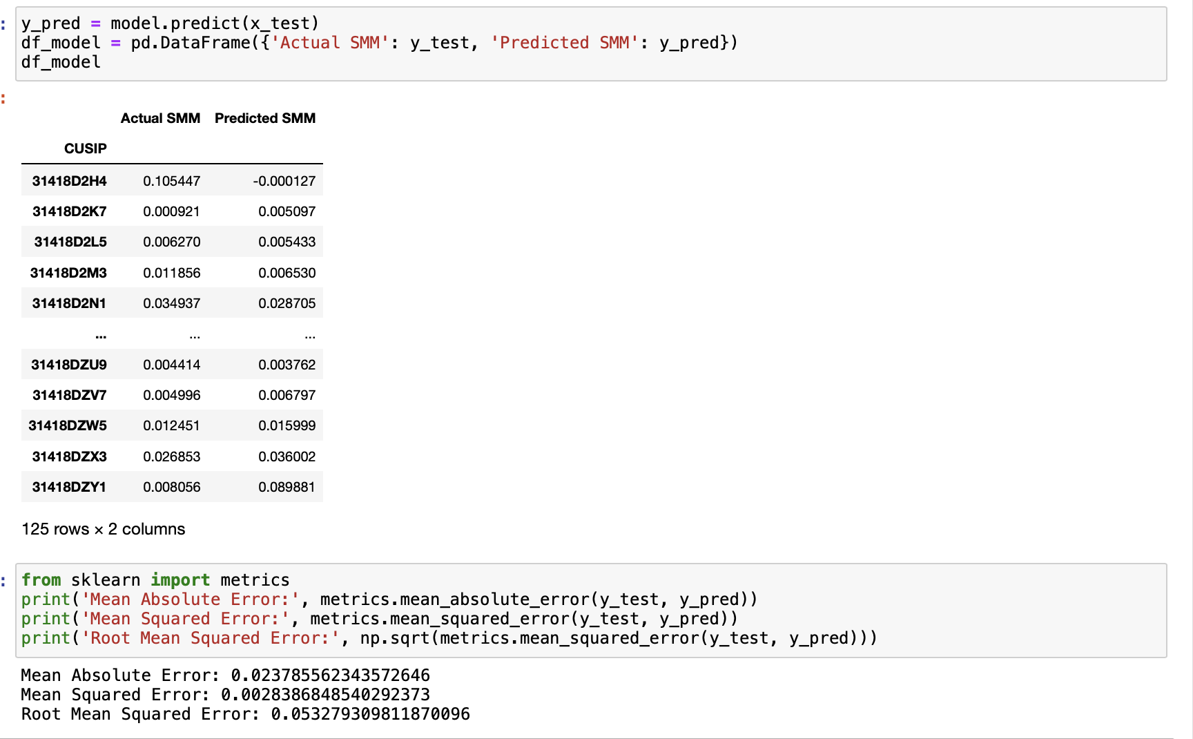
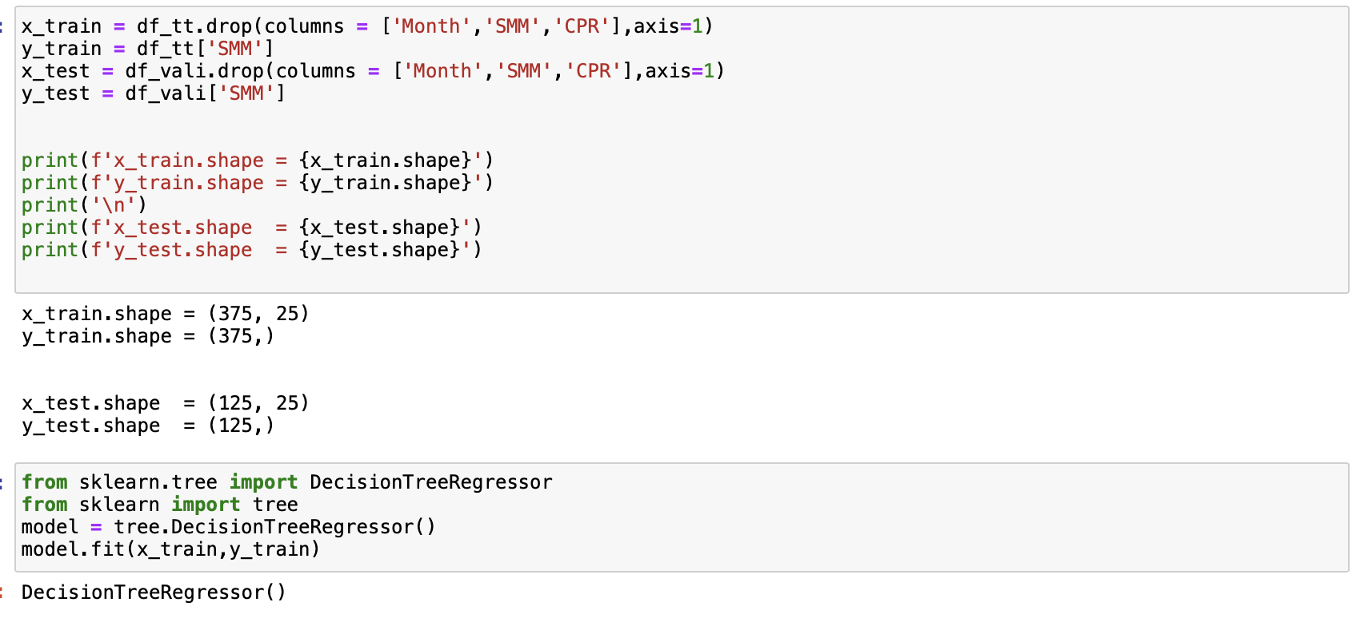
Decision Trees Model
Decision Trees
Rationale for using Decision Trees Model
3. Model testing
heterogeneous data
non parametric
easiness of interpretation
Read data and process
2. Model training
Source: Fannie Mae, Freddie Mac, Internal Analysis

Slide 19
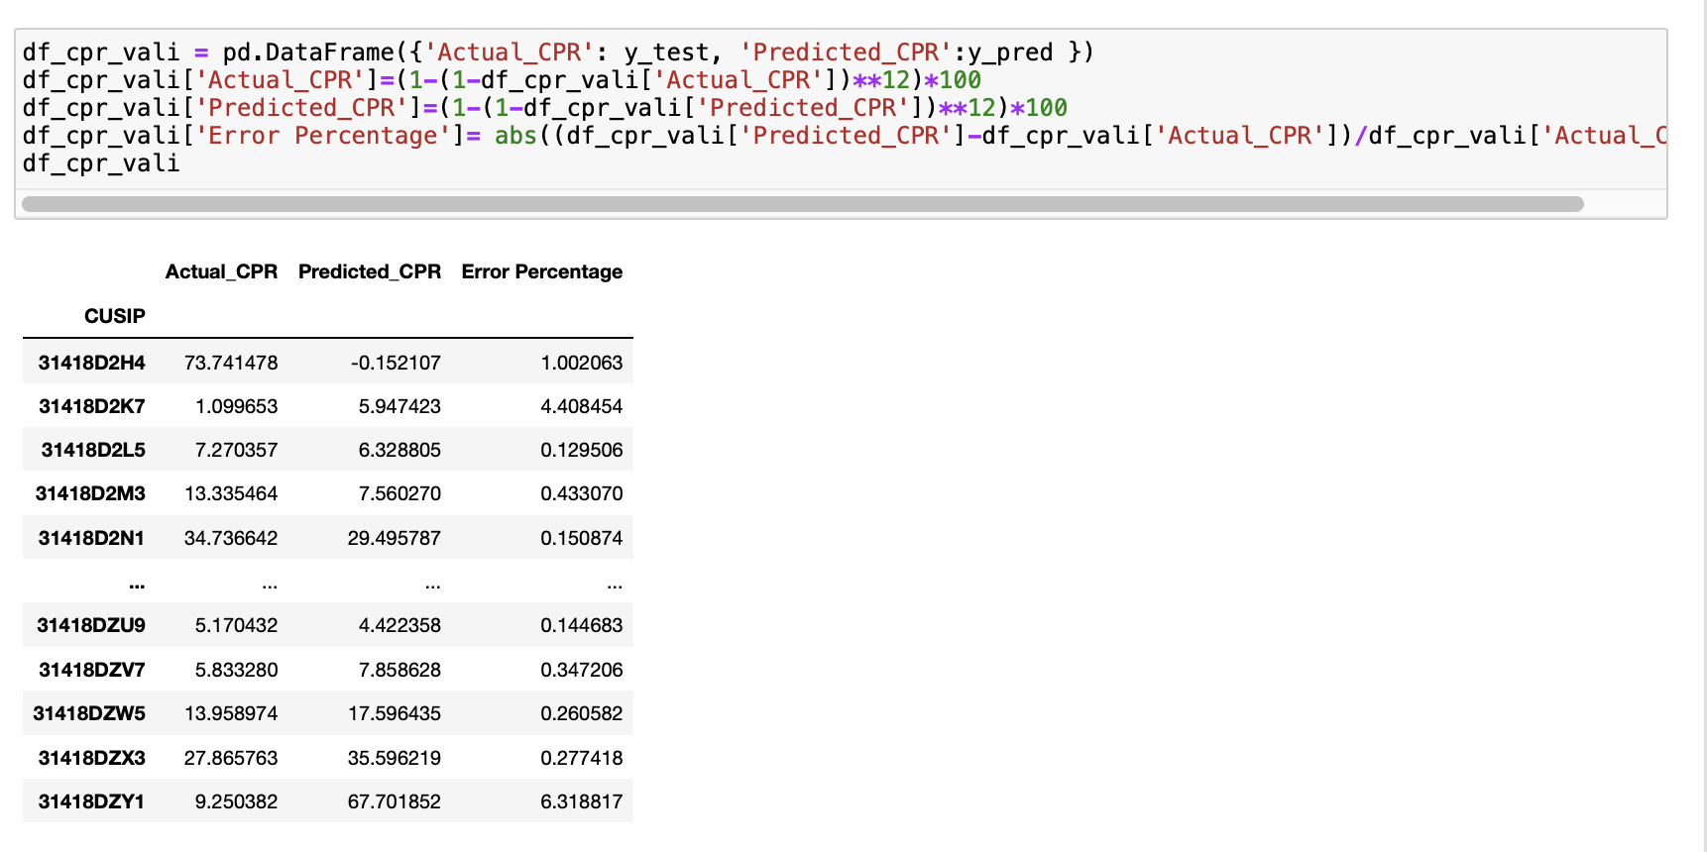
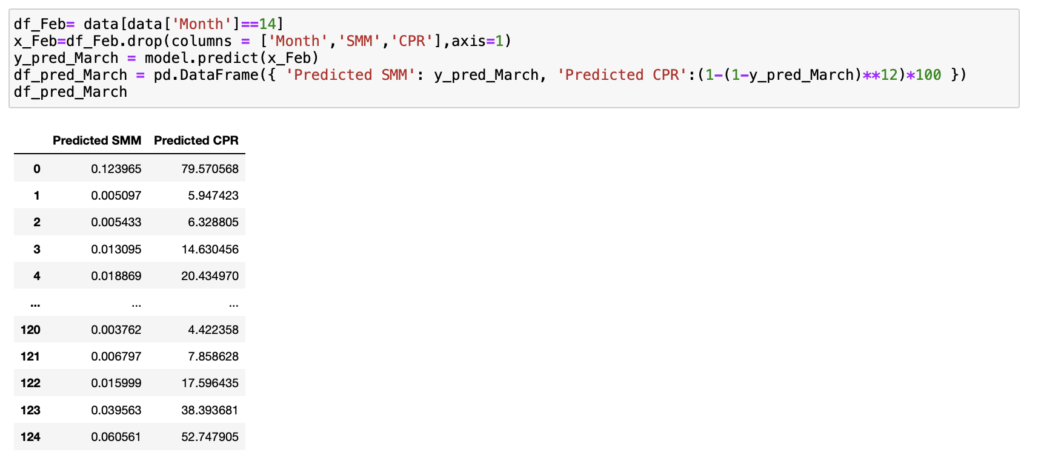
Decision Trees
4. SMM Prediction and CPR calculation

Slide 20
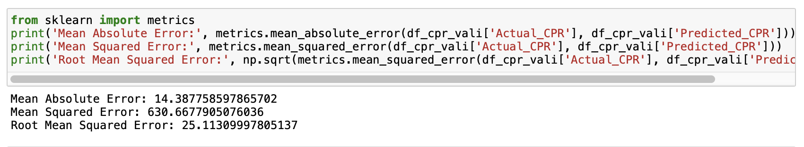
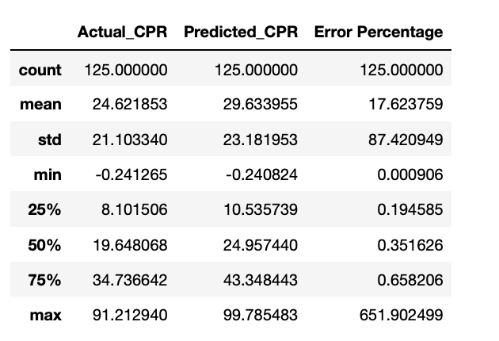
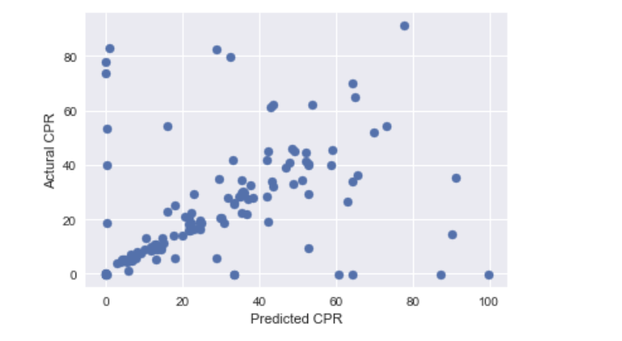
Decision Trees
5. Model Evaluation

Slide 21
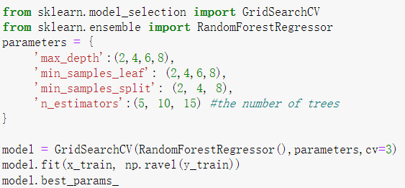
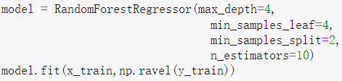
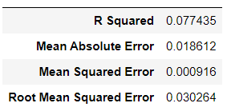
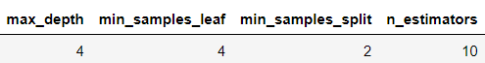
Random Forest Model
Random Forest
Model Tuning - GridSearch
Training Model
Training Results
Source: Fannie Mae, Freddie Mac, Internal Analysis

Slide 22
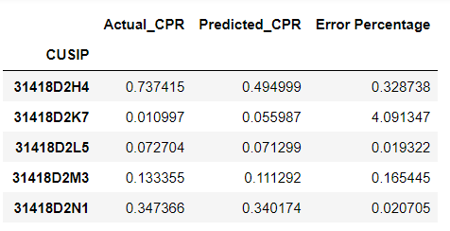
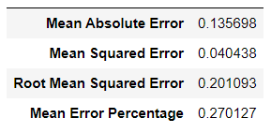
Random Forest Model
Random Forest
Model Testing
Testing Results
*Error Percentage = abs(actual CPR - predict CPR) / actual CPR
Source: Fannie Mae, Freddie Mac, Internal Analysis

Slide 23
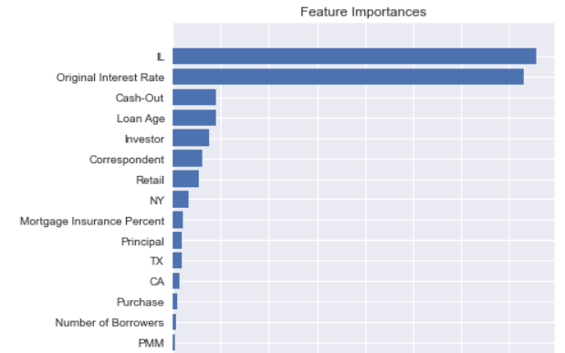
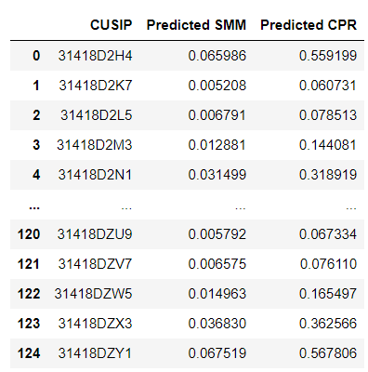
Random Forest Model
Random Forest
Model Feature Importance
Predicted SMM & CPR
Source: Fannie Mae, Freddie Mac, Internal Analysis

Slide 24
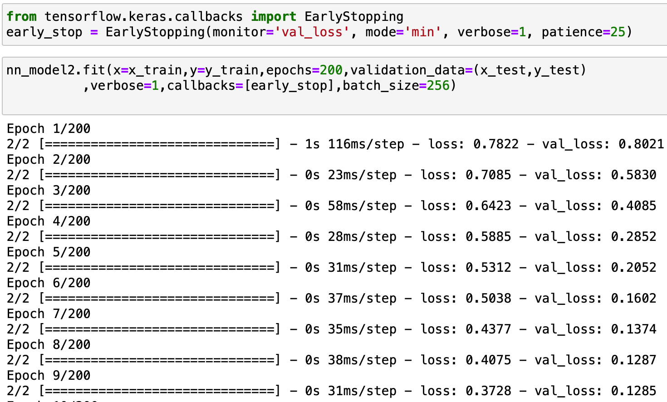

Neural Networks Model
Neural Networks
We tried different Parameters
…to come up with SMM predictions
Neural networks model can produce highly accurate fits to the historical prepayment trends and has the capacity to learn relationships from past data. It is also able to model large groups of risk measures that are potentially nonlinear and highly interactive.
Source: Fannie Mae, Freddie Mac, Internal Analysis

Slide 25


Neural Networks Model
Neural Networks
Graph the loss
…and outcome for SMM
Source: Fannie Mae, Freddie Mac, Internal Analysis

Slide 26


Neural Networks Model
Neural Networks
Model Testing
Comparing Actuals and Predicted
Mean Absolute Error: 0.027750483613300656
Mean Squared Error: 0.0017614652406482197
Root Mean Squared Error: 0.04196981344547793
Source: Fannie Mae, Freddie Mac, Internal Analysis

Slide 27


Gradient Descent Model
Gradient Descent
We tried different parameters to tune the model
…and yielded the following results
Gradient descent is an optimization algorithm that finds the optimal weights (a,b) that reduces prediction error.
Source: Fannie Mae, Freddie Mac, Internal Analysis

Slide 28


Gradient Descent Model
Gradient Descent
Model Testings
Model Feature Importance
Source: Fannie Mae, Freddie Mac, Internal Analysis

Slide 29


Gradient Descent Model
Gradient Descent
Our Eventual Predictions
…and Graphing the Difference between Actual and Predicted
Source: Fannie Mae, Freddie Mac, Internal Analysis

Slide 30
Parameter Selections
Future Improvements
In order to yield future outcomes in predicting CPR, we suggest the following things:
1 | Incorporate more Macroeconomic Factors
2 | Generate Individual Behavior Probability base on their Credit Score, etc. to predict likelihood of prepay
3 | Take into account more month to see the bigger picture
4 | Tune models with more possible parameters
5 | Incorporate neural networks with gradient descent

Slide 31


Overview
Our thoughts on the Future Trends in the Mortgage-Backed Securities Universe
Macroeconomics Influencing Factors
Market Snapshot
Monetary Policy Uncertainties:
Quantitative Tightening & Fed reducing the size of the balance sheet
Economic Uncertainty
Raise the target range for the federal funds rate
Interest Rate
on 15 yr Mortgage
4.88%
Inflation
8.3%
Unemployment
3.6%
Collateralized
Liquidity
Risk & Return
30 Year Fixed Mortgage Rates FY 17-22
Source: BLS, Fannie Mae, Freddie Mac, Internal Analysis
Notes:
Annual inflation rate in the US slowed to 8.3% in April from a 41-year high of 8.5% in March, but less than market forecasts of 8.1%.

Slide 32
Thank you
Any Questions?

Slide 33
Disclaimer
The content found in this document is for informational and educational purposes only and is not to be considered personal, legal or investment advice or a recommendation to buy or sell securities or any other product.
The content is based on opinions, public filings, current events, press releases and interviews but is not infallible. It may contain errors and writers offer no inferred or explicit warranty as to the accuracy of the information presented.
All writers’ opinions are their own and do not constitute financial advice in any way whatsoever. Nothing included in this document constitutes an investment recommendation.
By reading this document, you agree to hold the writers, affiliated institutions and partners harmless and to completely release them from any and all liabilities due to any and all losses, damages, or injuries (financial or otherwise) that may be incurred.

Slide 34
Appendix

Slide 35

Correlation Heat Map

Slide 36

Data Summary

Slide 37

Data Summary

